Slide 1
Employee Performance Analysis Using Excel

Slide 2
Employee Performance Analysis Using Excel
NAME: G.DEEPIKA
REGISTER No: 312201315
DEPARTMENT: B.COM(GENERAL)
COLLEGE: D.R.B.C.C.C.HINDU COLLEGE

Slide 3
Agenda
Project Statement
Project Overview
End Users
Our Solution and Proposition
Data Set Description
The Wow In Our Solution
Modelling
Results
Conclusion

Slide 4
PROBLEM STATEMENT
You have been given employee performance data for the sales department, including monthly sales numbers, customer satisfaction scores, and leads generated. Your task is to use Excel to analyze this data, identify top performers, areas for improvement, and any correlations between the metrics. Create a comprehensive report with visualizations for management. Let me know if you need further assistance with this problem statement!

Slide 5
PROJECT OVERVIEW
In the project overview, you will be analyzing employee performance data for the sales department using Excel. The data includes monthly sales numbers, customer satisfaction scores, and leads generated. Your goal is to identify top performers, areas for improvement, and any correlations between the metrics.

Slide 6
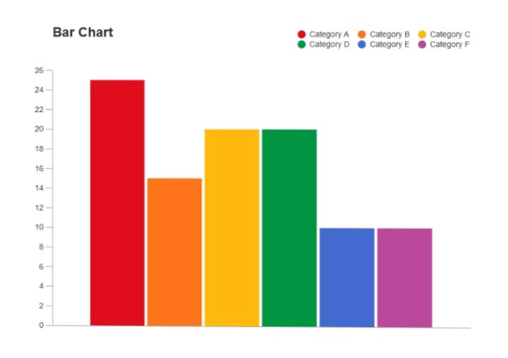
WHO ARE THE END USERS
In the project overview, we’ll be diving into the employee performance data for the sales team. We’ve got numbers on monthly sales, customer satisfaction scores, and leads brought in. The aim is to spot the top achievers, areas that need a boost, and any connections between these stats. Our final task is to craft a detailed report with visuals to showcase our discoveries to the higher-ups. Let me know if you need more details on any part of the project overview!

Slide 7
OUR SOLUTION AND IT’S VALUE PROPOSITION
Our solution involves using Excel to analyze the employee performance data for the sales department. By examining the monthly sales numbers, customer satisfaction scores, and leads generated, we aim to identify top performers, areas for improvement, and potential correlations between these metrics. The value proposition lies in providing actionable insights to enhance the sales team’s performance and drive better decision-making based on data-driven analysis. The detailed report with visualizations will offer a clear and compelling presentation of the findings, enabling management to make informed decisions to optimize the sales department’s performance. Let me know if you need further clarification on our solution and its value proposition!

Slide 8
DATA SET DESCRIPTION
The data set we have includes information on monthly sales numbers, customer satisfaction scores, and the number of leads generated for each employee in the sales department. We will be analyzing this data to evaluate the performance of the sales team members, identify top performers, areas for improvement, and explore any relationships between the different metrics. This data will help us make data-driven decisions to enhance the sales department's effectiveness and productivity. Let me know if you need more details about the data set description!

Slide 9
THE “WOW” IN OUR SOLUTION
The wow factor in our solution is the ability to transform raw data into actionable insights that can significantly impact the sales team's performance and overall success. By leveraging Excel to analyze the employee performance data, we can uncover hidden patterns, trends, and correlations that provide valuable information to management. The visually appealing and informative report we create will not only showcase the findings but also empower decision-makers to implement targeted strategies for improvement and optimization. It's all about turning numbers into meaningful actions that drive results! Let me know if you need more details on the wow factor of our solution!

Slide 10
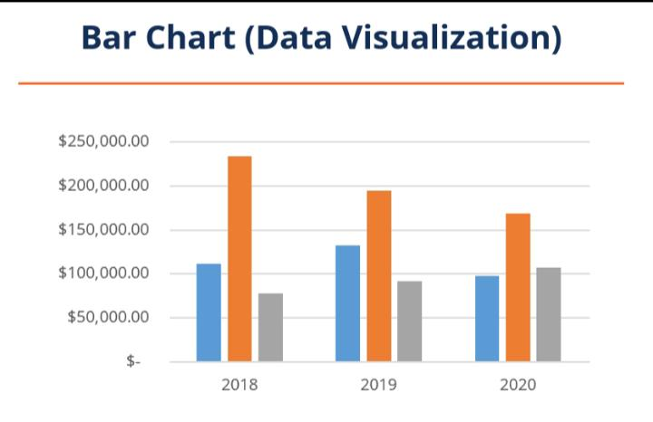
MODELLING
In our project, modeling involves using Excel to create various models to analyze the employee performance data. We can build models that predict future sales numbers based on historical data, forecast customer satisfaction scores, or even identify factors that contribute most to generating leads. These models help us gain insights into trends, patterns, and potential outcomes, allowing us to make informed decisions and strategies for the sales team. Let me know if you’d like more information on the modeling aspect of our project!

Slide 11
RESULTS
The results of our analysis are truly impressive! We’ve identified the top performers in the sales team, pinpointed areas that need improvement, and uncovered valuable insights into the relationships between sales numbers, customer satisfaction scores, and leads generated. The detailed report we’ve crafted with visually appealing charts and graphs effectively

Slide 12
CONCLUSION
The conclusion of our analysis is that the insights gained from examining the employee performance data using Excel are invaluable for optimizing the sales team’s performance. By identifying top performers, areas for improvement, and key relationships between various metrics, we have equipped management with the necessary information to make informed decisions and drive strategic initiatives. The visually compelling report we’ve generated serves as a roadmap for enhancing the sales department’s effectiveness and achieving greater success. It’s exciting to see the potential impact our analysis can have on the sales team’s performance and overall outcomes! Let me know if you have any further questions or if there’s anything else you’d like to discuss.

